Slide 1

1516
Lesson 1: Setup, expressions, naming

Slide 2
Learning Outcomes: Lesson 1
Python Setup
Variables
Naming Conventions
Built-in functions
Expressions
Types of Errors

Slide 3
Python Setup
Python 3 (3 or latest)
Download: https://www.python.org/downloads/
GitHub Developer Pack
https://education.github.com/pack
Pycharm IDE (2021 or latest)
Free Student License: https://www.jetbrains.com/community/education/#students
https://www.jetbrains.com/pycharm/download/#section=windows

Slide 4
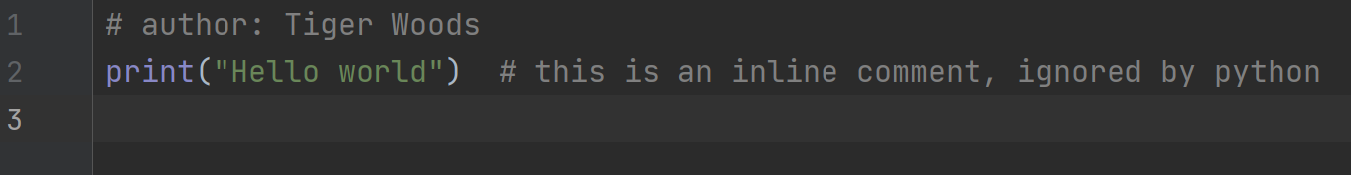
Comments
Comments are notes in the code, intended for people to read (not for the computer to read)
They are not interpreted or executed by the python interpreter, but are there to provide documentation in your code
Comments start with a # and last until the end of that line
In this course, always include a comment at the top of every file with your name

Slide 5
Style
Be readable and be consistent in how you code Python.
https://www.python.org/dev/peps/pep-0008
https://google.github.io/styleguide/pyguide.html
Consistency and readability and conventions are very, very important.
We will code according to the suggestions listed in the resources above.

Slide 6
Variables – Values and Types
A variable is a name that represents a value (with a data type) stored in the computer’s memory
Values have different types such as:
String anything in "quotation marks" or 'quotation marks' such as "Hello World!" or 'this' or '5'
Integer whole numbers such as 10, 567964, 101, -66, 0
Floating point decimal numbers such as 11.65, -0.001, 1200.0, 0.0
Boolean True or False
An assignment statement can create new variables; the next instruction assigns the integer value 5 to a variable named x
x = 5
An assignment statement gives variables a value using a single = equals sign
school_name = "bcit" # use lowercase letters and the_underscore for compound names
print(type(school_name)) # str the type() instruction tells what type a variable is

Slide 7
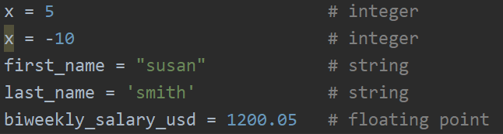
Variables - Examples
The type of the variables is based on the value stored in the variable
Note that in python, “double quotation marks” and ‘single quotation marks’ have the same meaning

Slide 8

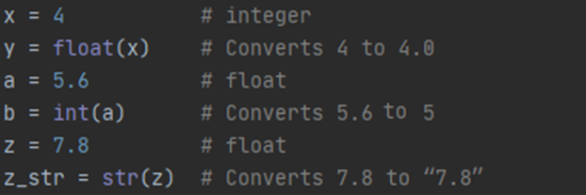
Variables - Types
The type of the variable will change if the type of the value changes
The type of a variable can be changed using built-in type functions (note: use this rarely)

Slide 9
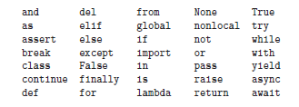
Naming Conventions
IMPORTANT: Always choose meaningful names that document what the variable is used for
https://en.wikipedia.org/wiki/Mars_Climate_Orbiter
Variable names can contain letters, digits, and the underscore character (but cannot start with a digit)
Cannot use reserved Python keywords; for example, these:

Slide 10
Naming Conventions
Use lower_snake_case for variables, modules and function names, like these:
my_input, first_name, last_name, weight_kg, year_born, print_result
Use UPPER_CASE for constants (i.e. whose values will never change)
PI = 3.14, GRAVITY_M_SEC_SQ = 9.8, LEAGUE_NAME = “Fifa”
Use UpperCamelCase only for classes (covered much later)
BankAccount, CoinFlip, Animal

Slide 11


Built-in Functions
Python can read input from the keyboard using the built-in input() instruction
Python can print to the console using the built-in print() instruction
After running this program, the console would look like this:

Slide 12


Built-in Functions
Reduce code:
The input() instruction can also print a prompt before reading keyboard input: (note: \n means newline)
Console

Slide 13
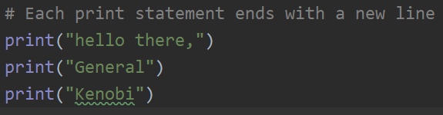



Built-in Functions
Output to the console (i.e. the screen) using the built-in function print() terminates the print with a newline character (i.e. acts like the user pressed Enter on the keyboard).
BUT: you can change it so the end is not a newline, but is something different:

Slide 14


Built-in Functions
Everything in python is an object, including variables like integers and strings. More will be discussed later on objects.
The built-in function type() will return the data type of an object
The built-in function id() will return the id of an object, an integer that uniquely identifies the object in a program. More may be discussed much later on this.

Slide 15
Arithmetic Operators
An expression is a combination of items that evaluates to a new value
variable – stored value, can have different values at different points in time
literal – specific value such as 2
operator – symbol that performs a built in calculation
Arithmetic Operators in Python:
+ Addition (x + y)
- Subtraction (x – y)
* Multiplication (x * y)
/ Division (x / y)
// Integer Division (result will be a whole number; any decimal portion is thrown away, not rounded)
** Exponent (x to the power of y)
% Modulus (remainder after dividing)

Slide 16
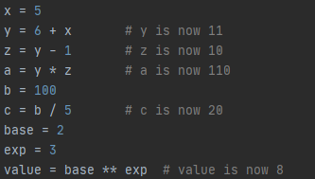
Arithmetic Operators
Some examples

Slide 17
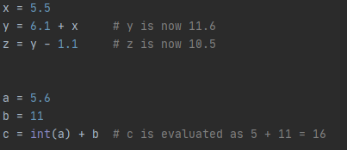
Arithmetic Operators
Some more examples

Slide 18
Categories of Errors
Syntax – The rules of the programming language
Syntax Error – A violation of the programming language rules. Usually caught by the interpreter before any lines of the program are run.
Run your program frequently to catch these errors, especially while you are new to programming
Very common error for new programmers is a typo. Make sure everything is spelled correctly and names match (Python is case sensitive… school_name is a different variable than School_Name, etc…)

Slide 19
Categories of Errors
Runtime Error – When the program is run by the interpreter and then crashes
Runtime Error – Correct syntax but the program attempts to do something that is impossible such as dividing by zero or trying to multiply strings.
The program immediately stops and reports an error at the line of code being run so it is often called a crash.
Common Runtime Error Types in Python:
SyntaxError – Code that cannot be understood (but was not caught at startup)
IndentationError – Lines of the program are not indented correctly
ValueError – Invalid value is used (i.e., passing a string value to int())
NameError – Program tries to use a variable that does not exist
TypeError – An operation uses incorrect types (i.e., adding an integer to a string)

Slide 20
Categories of Errors
Semantic – The intended purpose of your program is not being met
Semantic Error – Your program runs but does not do what you intended it to do. Also known as a Logic Error or “bug”.
Examples:
Your program is supposed to add x and y and print the result, but always prints the value of x
Your program is supposed to load in data from a file, but the variable holding that data is always empty

Slide 21
Programming Best Practices/Advice
Make your code readable to others:
Use comments to describe why you’ve done something
Use whitespace (e.g., blank lines) to group related bunches of code
Put units on variable names (e.g. weight_kg instead of weight)
Don’t be afraid to ask for clarification… but do try to understand things yourself, first
Don’t be afraid to experiment with your code
You can’t cause any serious harm (generally)
You can always recover
Worst case: you start writing your program over again (for simple programs)

Slide 22
Coming Up
Next week we have a quiz based on this lesson, at the end of that lesson (Activities → Quizzes → Quiz 1)
This week we have a lab based on this lesson; work with a partner; submit it before next class to the Learning Hub (Activities → Assignments → Lab 1)
Also already posted is a larger project, due in several weeks; look at this soon to get its overall idea
Do lesson 2’s pre-reading and pre-class exercises before next lesson (also, do lesson 1’s pre-reading since we didn’t have the opportunity yet)

